Slide 1
Single Strap Antenna
Antenna box from x=0
Plasma from x=x_plasma
w_strap
d_wall
d_strap
y
y
e_strap
h_box
h_strap
x
z
vacuum
w_box
d_box
Name Value Unit "Evaluated Value" Type
D_strap 40 mm 40mm Design
e_strap 15 mm 15mm Design
w_strap 120 mm 120mm Design
h_strap 200 mm 200mm Design
w_box 200 mm 200mm Design
d_box 160 mm 160mm Design
h_box 250 mm 250mm Design
x_plasma 10 mm 10mm Design
w_vacuum 550 mm 550mm Design
h_vacuum 800 mm 800mm Design
d_vacuum 400 mm 400mm Design
d_plasma "d_vacuum -x_plasma" 390mm Design
h_plasma h_vacuum 800mm Design
w_plasma w_vacuum 550mm Design
F = 50 MHz
I = 1 A

Slide 2
Double Straps Antenna
Antenna box from x=0
Plasma from x=x_edge
w_strap
d_wall
delta_strap
d_strap
y
y
e_strap
h_box
h_strap
x
z
vacuum
w_box
d_box

Slide 3
Plasma Configurations
n_e
n_e0
Constant density plasma
0
x_plasma
x
n_e
Dn_e0
Single gradient plasma
n_e0
0
x_plasma
x
x_plasma=0.05
ANTITER: Base density for vacuum is n_edge=1e11
This is made for numerics but has a very low impact on kperp in vacuum

Slide 4
First case: Double strap – constant profile

Slide 5
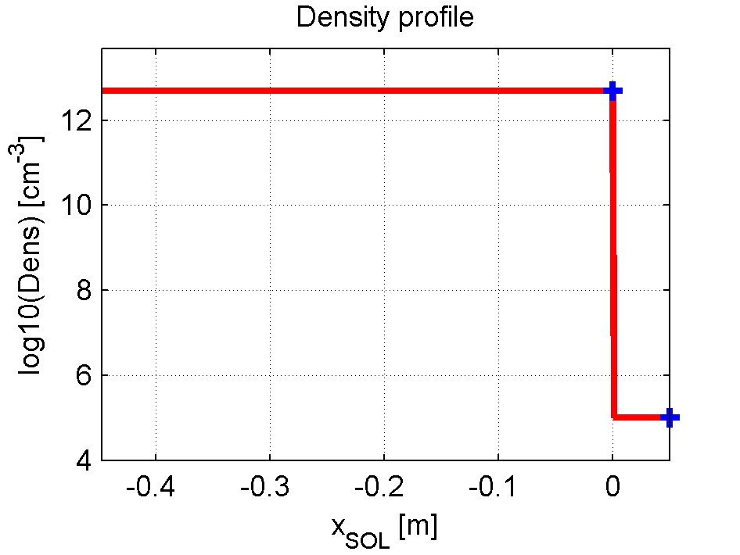
Plasma Configuration
Constant density plasma
n_e
Units:
Lengths: m
Density: m-3
!! ANTITIER
Density: cm-3
n_e0
Constant density plasma
0
x_plasma
x
x_plasma=0.05
n_e0=5e18
ANTITER uses a slightly different reference system
n_e
n_e0
x
0
x_ant=x_plasma

Slide 6
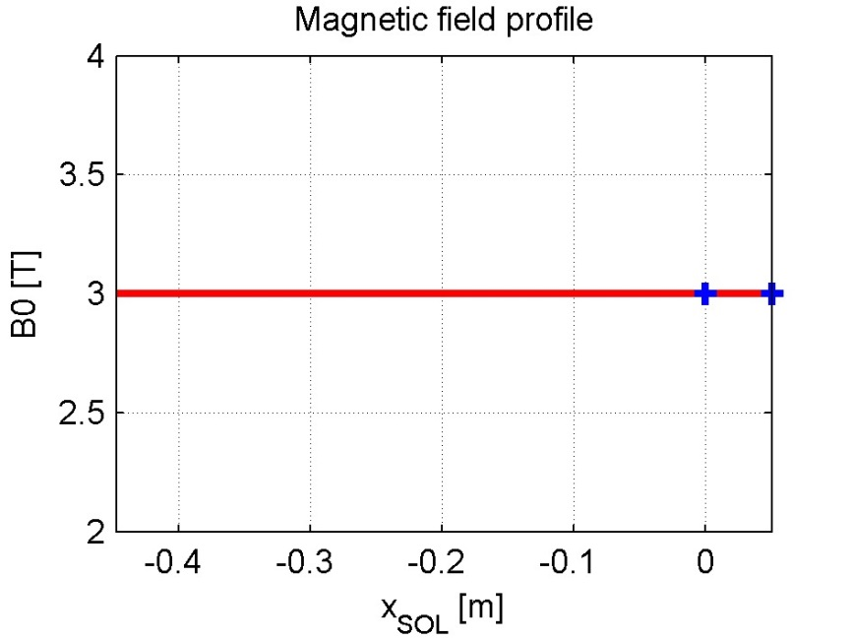
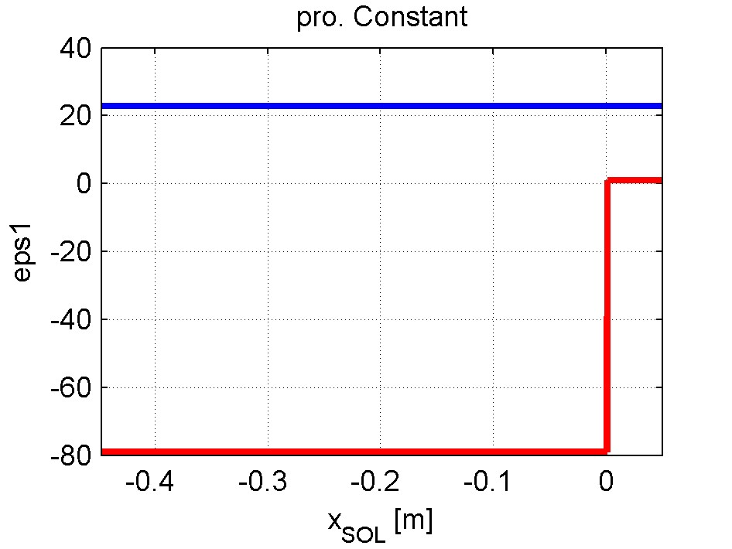
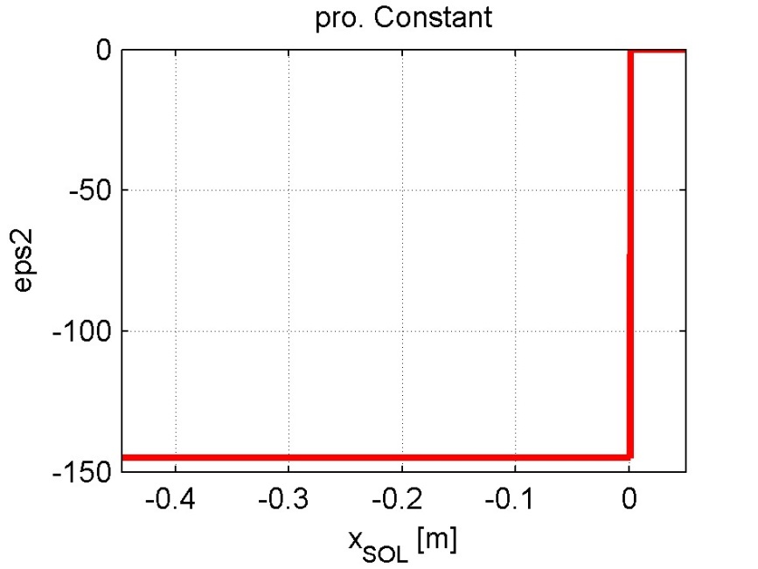
Plasma Configuration
Constant density plasma
B is taken constant but could have the usual 1/R dependency
f=50MHz
D(H)5%
ANTITER is considering only the fast magneto-sonic wave (FMW) so the palsma is described by eps1 ( Stix S) and eps2 (Stix D)

Slide 7
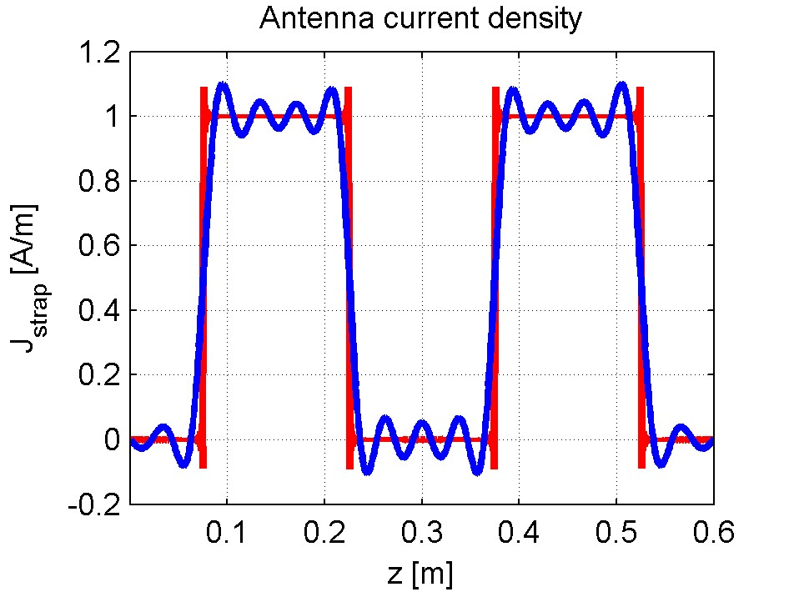
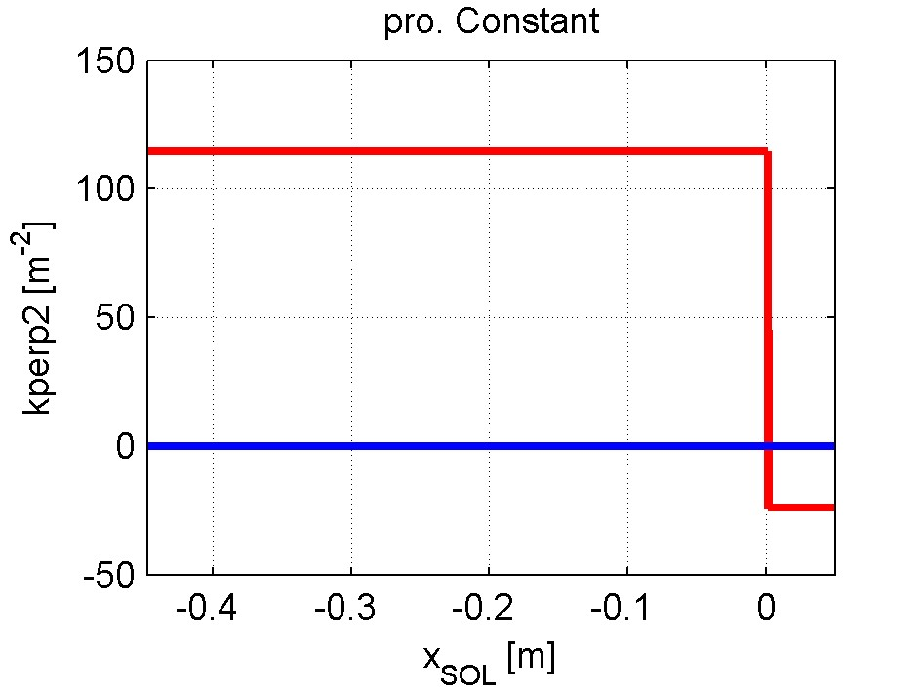
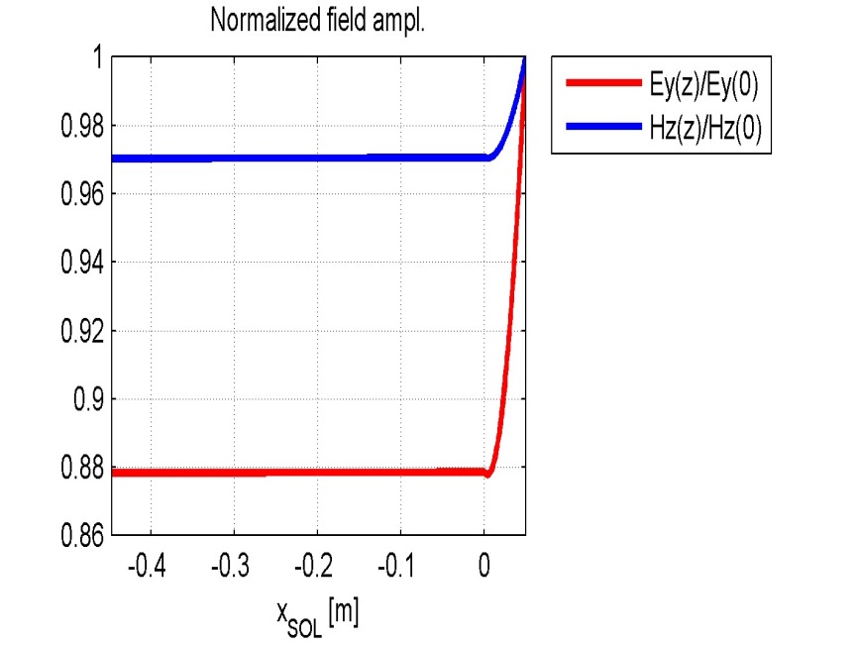
Plasma Configuration
Constant density plasma
30 elements in the expansion of J.
(Seems enough, checked for convergence. Could be increased.)
f=50MHz
D(H)5%

Slide 8
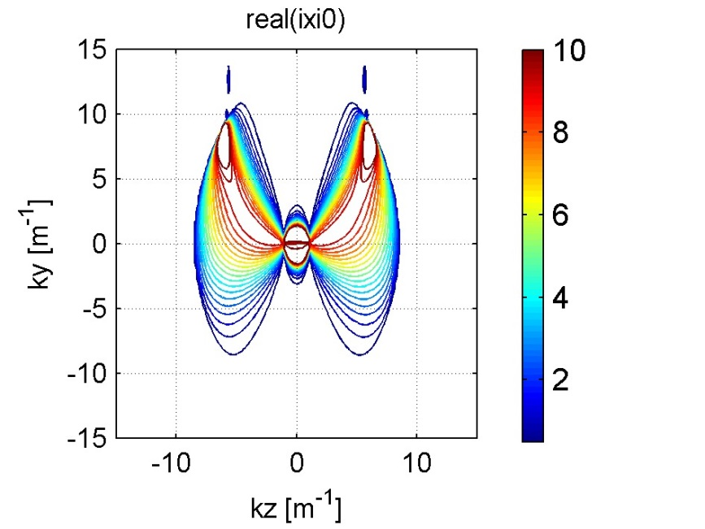
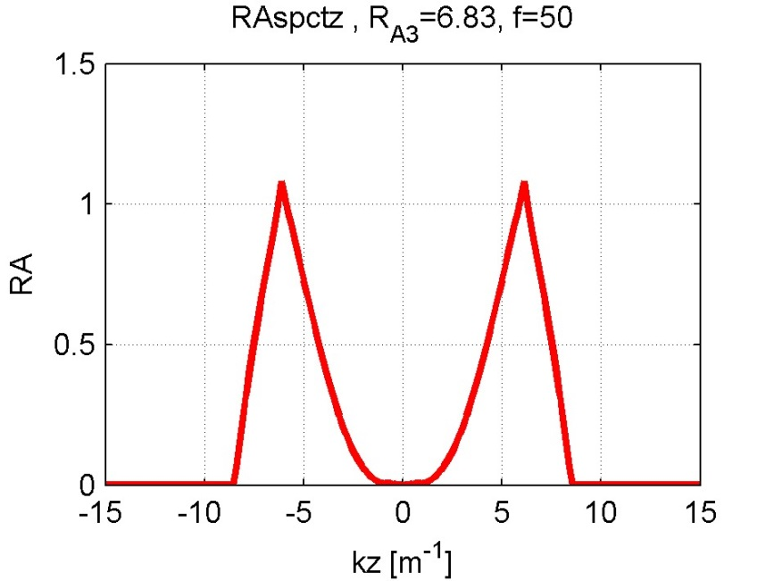
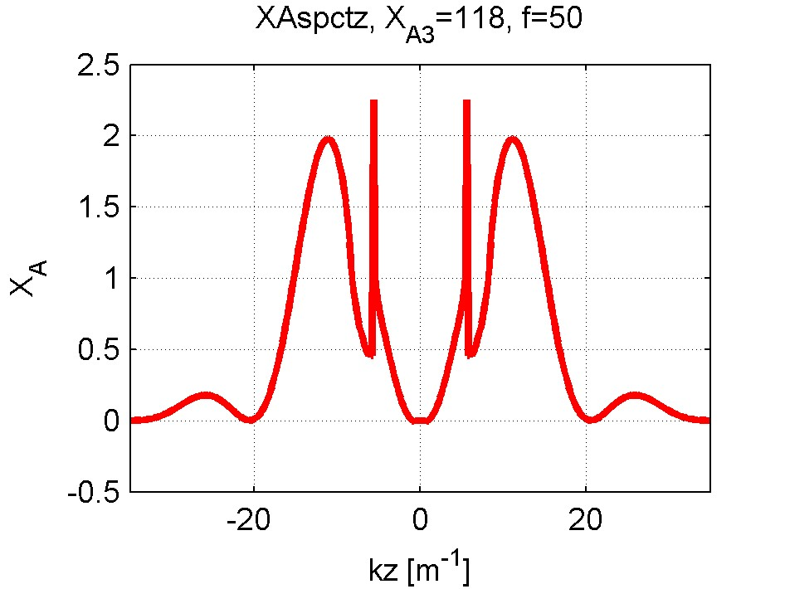
Plasma Response
Constant density plasma
B is taken constant but could have the usual 1/R dependency
f=50MHz
D(H)5%
Z₁₁=(14.7-i130.6)ohm/m
Z₂₁=(7.88-i12.25)ohm/m
Dipole phasing
Z_{A}=R_{A3}+iX_{A3}

Slide 9
Second case: Double strap – linear profile

Slide 10
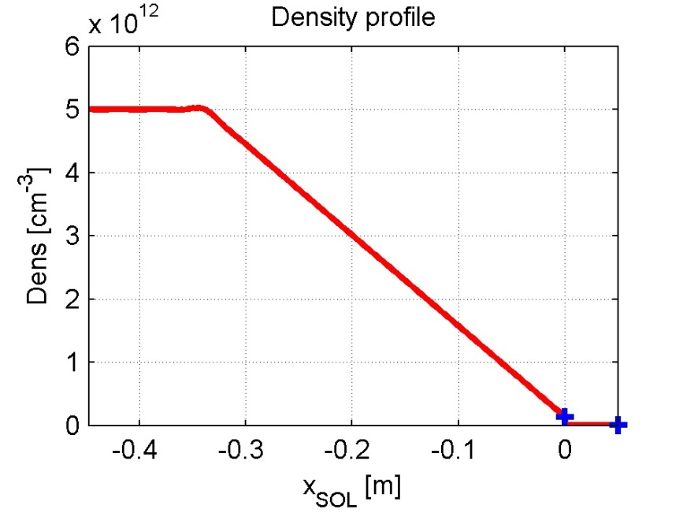
Plasma Configuration
Linear density plasma
Dn_e0
Units:
Lengths: m
Density: m-3
!! ANTITIER
Density: cm-3
Single gradient plasma
n_e0
0
x_plasma
x
x_plasma=0.05
n_e0=1e17
n_e1=5e18
ANTITER uses a slightly different reference system
n_e
n_e1
n_e0
x
0
x_ant=x_plasma

Slide 11
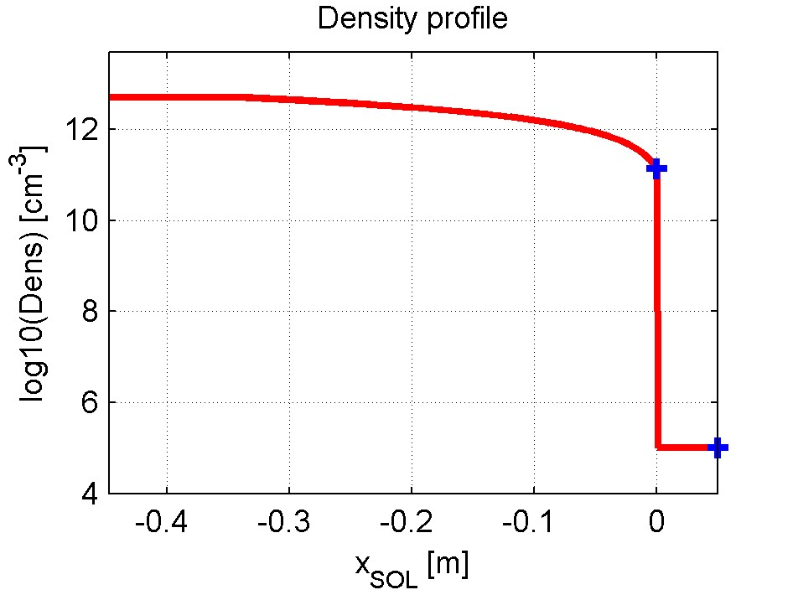
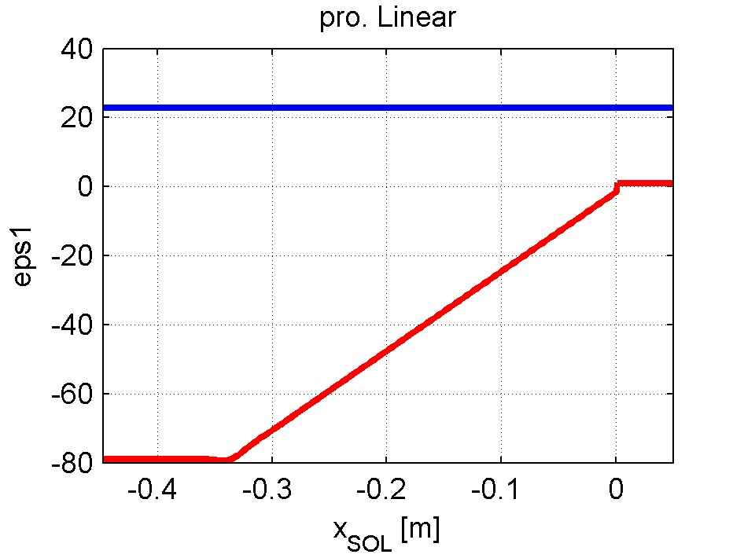
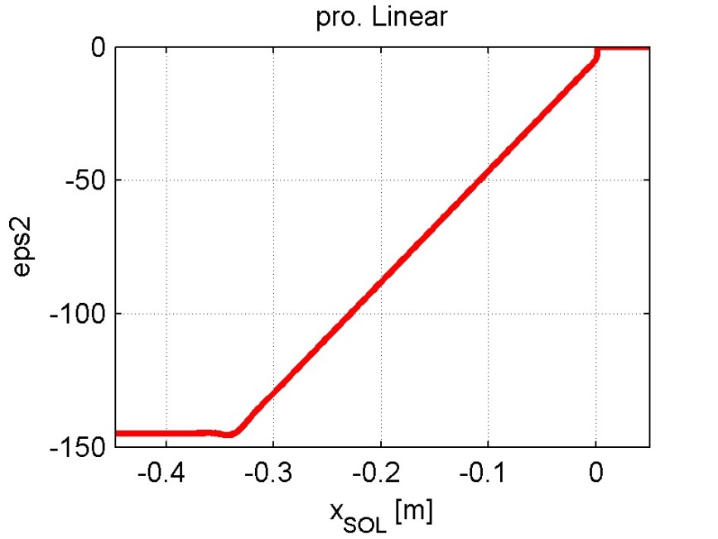
Plasma Configuration
Linear density plasma
B is taken constant but could have the usual 1/R dependency
f=50MHz
D(H)5%

Slide 12
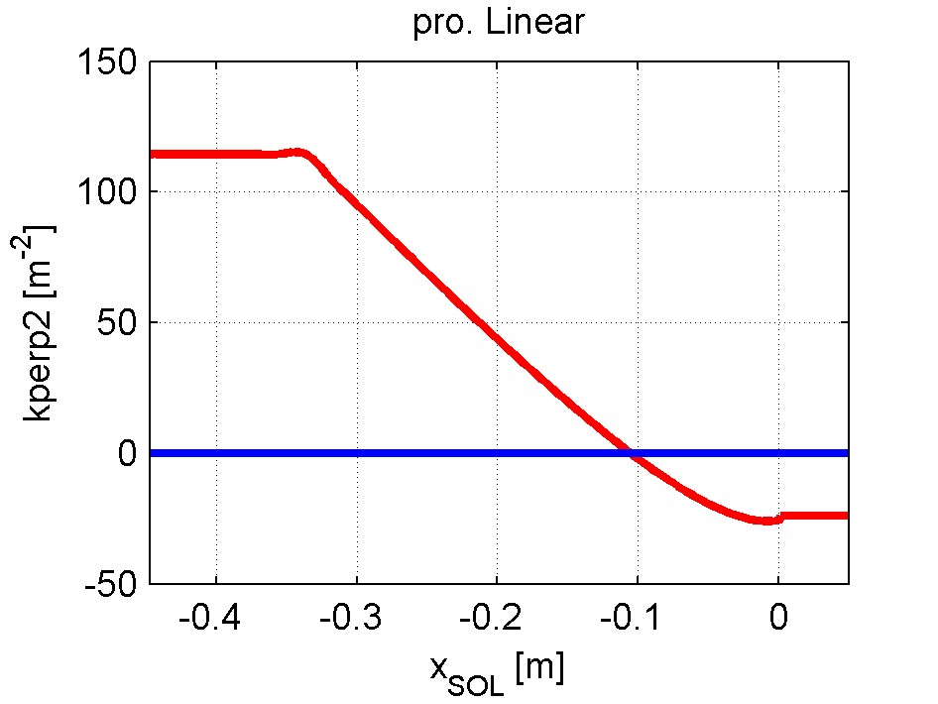
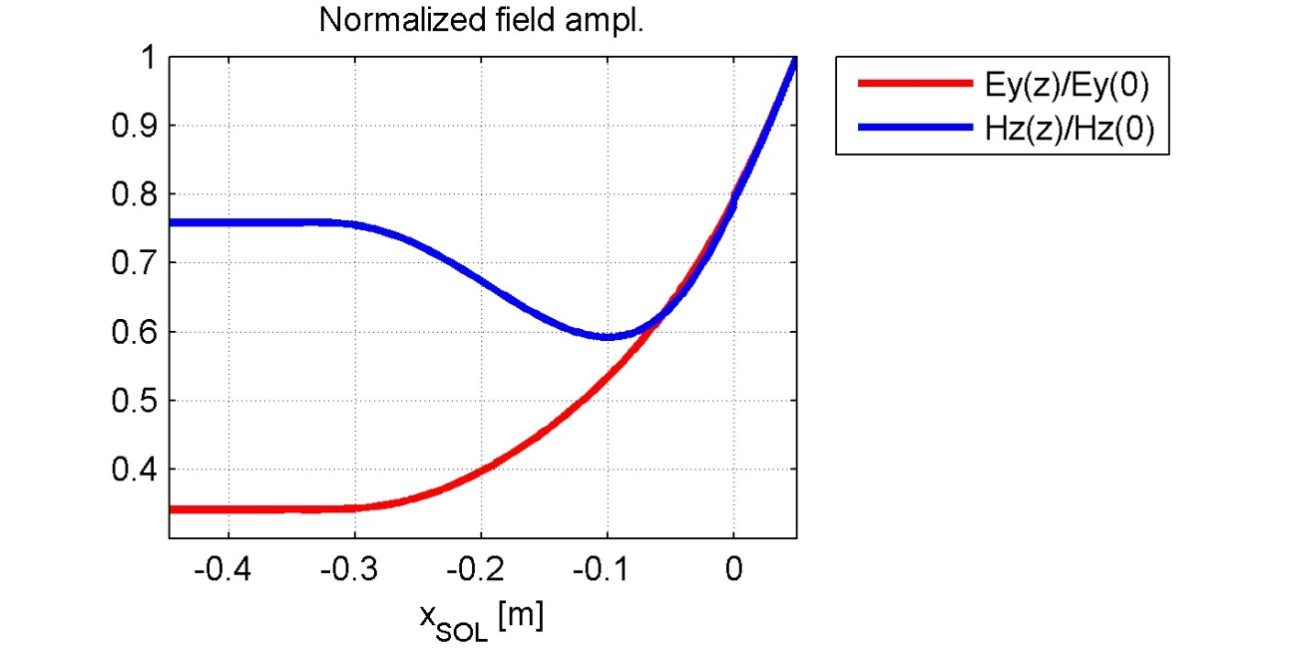
Plasma Configuration
Linear density plasma
30 elements in the expansion of J.
(Seems enough, checked for convergence. Could be increased.)
f=50MHz
D(H)5%

Slide 13
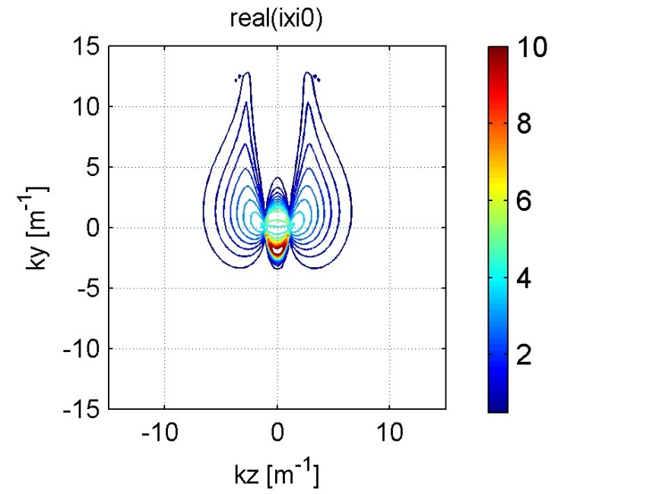
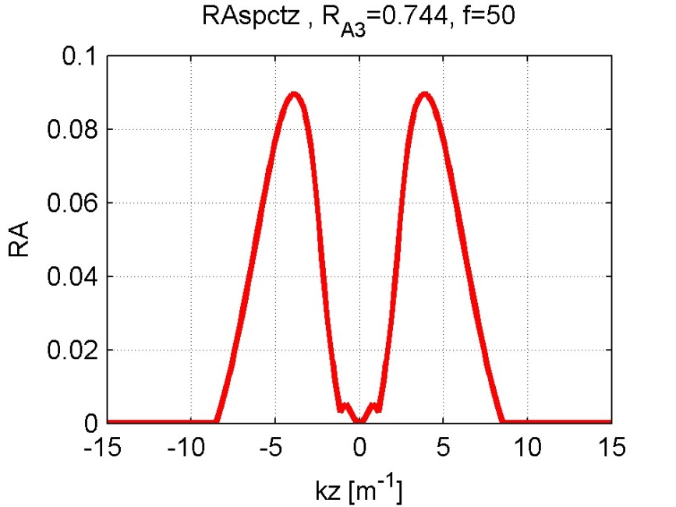
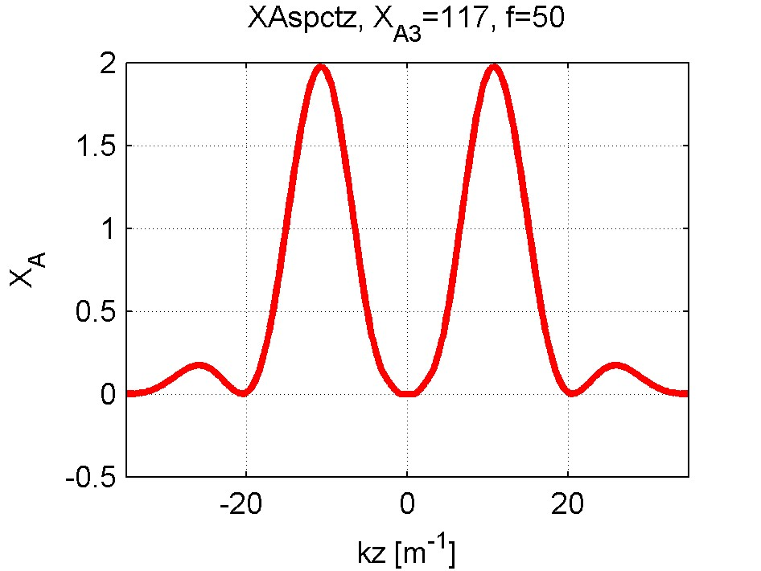
Plasma Response
Linear density plasma
B is taken constant but could have the usual 1/R dependency
f=50MHz
D(H)5%
Z₁₁=(4.42-i135.34)ohm/m
Z₂₁=(3.68-i18.78)ohm/m
Dipole phasing
Z_{A}=R_{A3}+iX_{A3}

